Slide 1
GROUP: 21 RUDRA SAITEJA: 21CE30025 SACHIN KUMAR REPSWAL: 21CE30026 TOPIC :Forecasting Time Series ARMA Model
1

Slide 2
ACF AND PACF
ACF (Auto Correlation Function)
Auto Correlation function takes into consideration of all the past observations irrespective of its effect on the future or present time period. It calculates the correlation between the t and (t-k) time period. It includes all the lags or intervals between t and (t-k) time periods. Correlation is always calculated using the Pearson Correlation formula.
PACF(Partial Correlation Function)
The PACF determines the partial correlation between time period t and t-k. It doesn’t take into consideration all the time lags between t and t-k. For e.g. let's assume that today's stock price may be dependent on 3 days prior stock price but it might not take into consideration yesterday's stock price closure. Hence we consider only the time lags having a direct impact on future time period by neglecting the insignificant time lags in between the two-time slots t and t-k.
13

Slide 3
How to differentiate when to use ACF and PACF?
Let's take an example of sweets sale and income generated in a village over a year. Under the assumption that every 2 months there is a festival in the village, we take out the historical data of sweets sale and income generated for 12 months. If we plot the time as month then we can observe that when it comes to calculating the sweets sale we are interested in only alternate months as the sale of sweets increases every two months. But if we are to consider the income generated next month then we have to take into consideration all the 12 months of last year.
So in the above situation, we will use ACF to find out the income generated in the future but we will be using PACF to find out the sweets sold in the next month.

Slide 4
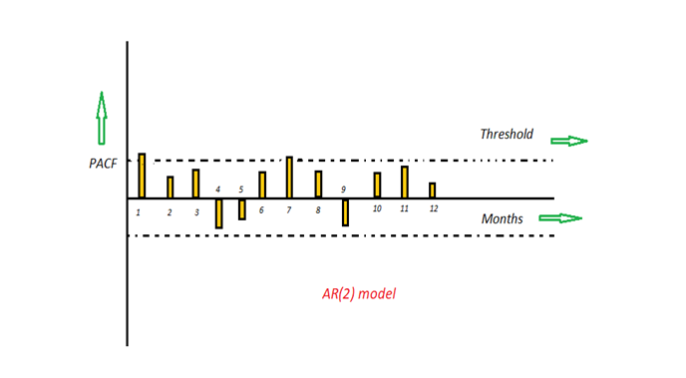
AR (Auto-Regressive) Model

Slide 5
The time period at t is impacted by the observation at various slots t-1, t-2, t-3, ….., t-k. The impact of previous time spots is decided by the coefficient factor at that particular period of time. The price of a share of any particular company X may depend on all the previous share prices in the time series. This kind of model calculates the regression of past time series and calculates the present or future values in the series in know as Auto Regression (AR) model.
Yt = β₁* y-₁ + β₂* yₜ-₂ + β₃ * yₜ-₃ + ………… + βₖ * yₜ-ₖ
Consider an example of a milk distribution company that produces milk every month in the country. We want to calculate the amount of milk to be produced current month considering the milk generated in the last year. We begin by calculating the PACF values of all the 12 lags with respect to the current month. If the value of the PACF of any particular month is more than a significant value only those values will be considered for the model analysis.
For e.g in the above figure the values 1,2, 3 up to 12 displays the direct effect(PACF) of the milk production in the current month w.r.t the given the lag t. If we consider two significant values above the threshold then the model will be termed as AR(2).
15

Slide 6
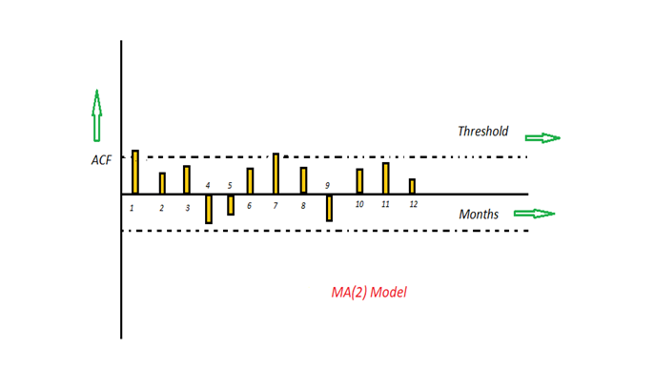
MA (Moving Average) Model

Slide 7
The time period at t is impacted by the unexpected external factors at various slots t-1, t-2, t-3, ….., t-k. These unexpected impacts are known as Errors or Residuals. The impact of previous time spots is decided by the coefficient factor α at that particular period of time. The price of a share of any particular company X may depend on some company merger that happened overnight or maybe the company resulted in shutdown due to bankruptcy. This kind of model calculates the residuals or errors of past time series and calculates the present or future values in the series in know as Moving Average (MA) model.
Yt = α₁* Ɛₜ-₁ + α₂ * Ɛₜ-₂ + α₃ * Ɛₜ-₃ + ………… + αₖ * Ɛₜ-ₖ
Consider an example of Cake distribution during my birthday. Let's assume that your mom asks you to bring pastries to the party. Every year you miss judging the no of invites to the party and end upbringing more or less no of cakes as per requirement. The difference in the actual and expected results in the error. So you want to avoid the error for this year hence we apply the moving average model on the time series and calculate the no of pastries needed this year based on past collective errors. Next, calculate the ACF values of all the lags in the time series.

Slide 8
If the value of the ACF of any particular month is more than a significant value only those values will be considered for the model analysis.
For e.g in the above figure the values 1,2, 3 up to 12 displays the total error(ACF) of count in pastries current month w.r.t the given the lag t by considering all the in-between lags between time t and current month. If we consider two significant values above the threshold then the model will be termed as MA(2).

Slide 9
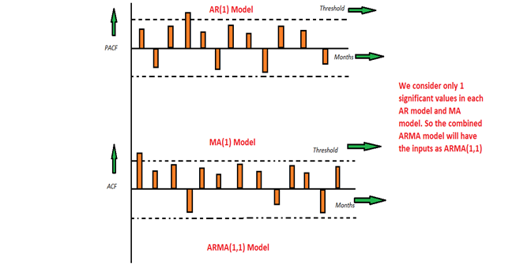
ARMA (Auto Regressive Moving Average) Model

Slide 10
This is a model that is combined from the AR and MA models. In this model, the impact of previous lags along with the residuals is considered for forecasting the future values of the time series. Here β represents the coefficients of the AR model and α represents the coefficients of the MA model.
Yt = β₁* yₜ-₁ + α₁* Ɛₜ-₁ + β₂* yₜ-₂ + α₂ * Ɛₜ-₂ + β₃ * yₜ-₃ + α₃ * Ɛₜ-₃ +………… + βₖ * yₜ-ₖ + αₖ * Ɛₜ-ₖ
Consider the above graphs where the MA and AR values are plotted with their respective significant values. Let's assume that we consider only 1 significant value from the AR model and likewise 1 significant value from the MA model. So the ARMA model will be obtained from the combined values of the other two models will be of the order of ARMA(1,1).

Slide 11

Forecasting ARMA
Characteristics
Forecasts from stationary models revert to mean
Integrated models revert to trend (usually a line)
Accuracy deteriorates as extrapolate farther
Variance of prediction error grows
Prediction intervals at fixed coverage (e.g. 95%) get wider
Calculations
Fill in unknown values with predictions Pretend estimated model is the true model
Example: ARMA (2,1) Yt = δ + φ1 Yt-1 + φ2 Yt-2 + at - θ1 at-1
One-step ahead: Ŷn+1 = δ + φ1 Yn + φ2 Yn-1 + (ân+1=0) - θ1 ân
Two Three
Ŷn+2 = δ + φ1 Ŷn+1 + φ2 Yn + (ân+2=0) - θ1 (ân+1=0)
Ŷn+3 = δ + φ1 Ŷn+2 + φ2 Ŷn+1 +
0 + 0
AR gradually damp out, MA terms disappear
(as in autocorrelations)
5

Slide 12
Accuracy of Forecasts
Assume
Estimated model is true model
Key fact
ARMA models represent Yt as weighted sum of past errors
Theory: Forecasts omit unknown error terms
Yn+1 = μ + an+1 + w1 an + w2 an-1 + w3 an-2 +…
“known”
w1 an + w2 an-1 + …
→ Yn+1 - Ŷn+1 = an+1
Ŷn+1 = μ +
Yn+2 = μ + an+2 + w1 an+1 + w2 an + w3 an-1 +…
Ŷn+2 = μ +
w2 an + w3 an-1 +…
→ Yn+2 - Ŷn+2 = an+2 + w1 an+1
Variance of forecast error grows as (at are iid)
σ²(1 + w ² + w ² + …)
1 2
6

Slide 13
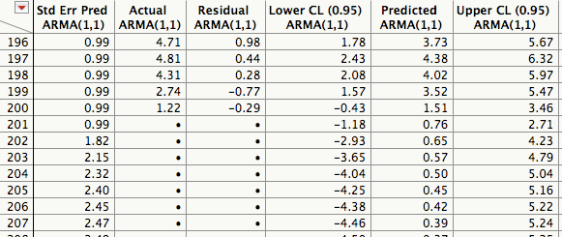
Example: ARMA(1,1)
Simulated data
Know that we’re fitting the right model Compare forecasts to actual future values
δ is not the mean of the series
Estimated model
Parameter Estimates
δ
Term AR1 MA1
Intercept
Constant
Estimate Estimate
0.7467 0.07988923
-0.7954
0.3154
intercept = mean
Reverse sign on moving average estimates
Forecasts
n=200 ŷ201=0.080+0.75(1.22)+0.80(-0.29) ŷ202=0.080+0.75(0.76)+0.80(0) ŷ203=0.080+0.75(0.65)
ŷn+f= δ + φyn+f-1 - θan+f-1
SD(y) = 2.50
0.315
7

Slide 14
Forecasts
Forecasts revert quickly to series mean Unless model is non-stationary or has very strong autocorrelations
Prediction intervals open as extrapolate Variance of prediction errors rapidly approaches series variance
10.00
5.00
0.00
-5.00
Y
observed
196 198 200 202 204 206 208 210
Rows
forecast
-10.00
8

Slide 15
EXAMPLE
Consider a situation of counting the number of vehicles travelled on a highway throughout the year. Let’s say we are given with the previous year’s data. Now using this data we can predict the total number of vehicles this year to some degree of accuracy.
If there is any unforeseen situation like covid pandemic during a year then it definitely impacts the transportation to a great extent. In such case the above formula doesn’t work efficiently. Then we need to introduce error concept into this to get the no. of vehicles for some interval till it reaches the normal phase and then combine both of them to get the final result.
By observing we can say that the first case relies on AR model and the second relies on MA model. Both combines to give the ARMA model.

Slide 16
Review
Autoregressive, moving average models
AR(p)
Yt = δ + φ1 Yt-1 + φ2 Yt-2 + … + φp Yt-p + at
MA(q)
Yt = μ + at - θ1 at-1 - θ2 at-2 -. . - θq at-q
ARMA(p,q)
Yt = δ + φ1 Yt-1 + φ2 Yt-2 + at - θ1 at-1
Watch negative signs
ARMA(2,1)
Common feature
Every stationary ARMA model specifies Yt as a weighted sum of past error terms
Yt = at + w1 at-1 + w2 at-2 + w3 at-3 +…
e.g., AR(1) sets wj = φ^{j}
ARMA models for non-stationary data
Differencing produces a stationary series.
These differences are a weighted average of prior errors.
3

